Slide 1
Dyslexia Awareness Week
1 - 7 November 2023
Dyslexia Scotland
Cameron House
Forthside Way
Stirling
FK8 1QZ
Helpline: 0344 800 8484
info@dyslexiascotland.org.uk
Charity No. SC 000951
Notes:
We are taking part in Dyslexia Awareness Week 2023.
Our aim is to raise awareness of Dyslexia.

Slide 2
What is dyslexia?
Dyslexia is a learning difference that is common
The brain simply works in a different way
Dyslexia has nothing to do with intelligence
Everyone with dyslexia is different
Notes:
What is Dyslexia?
Dyslexia is a learning difference that is common
The brain simply works in a different way
Dyslexia has nothing to do with intelligence
Everyone with dyslexia is different

Slide 3
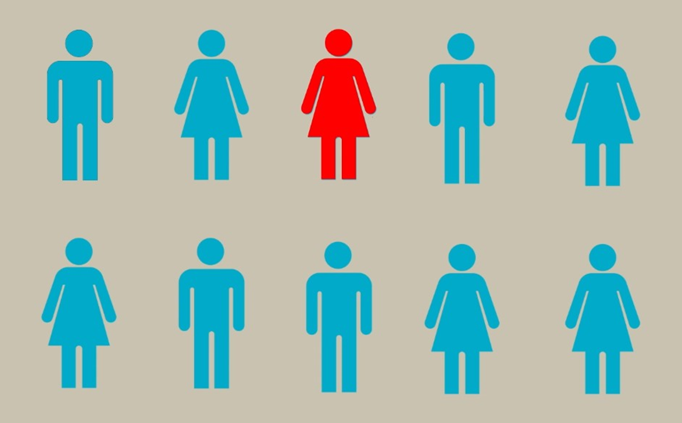
How many people are dyslexic?
1 out of every 10 people is dyslexic
Notes:
How many people are dyslexic?
1 out of every 10 people is dyslexic.

Slide 4
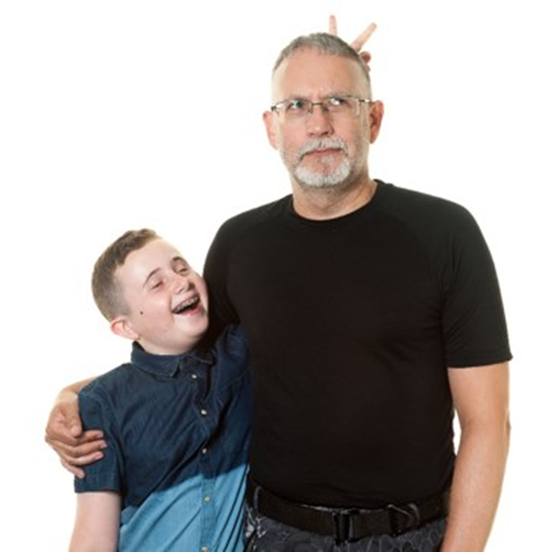
Did you know?
Dyslexia often runs in the family.
Brennus and his dad are both dyslexic.
Notes:
Did you know?
Dyslexia often runs in the family.
Brennus and his dad are both dyslexic.

Slide 5
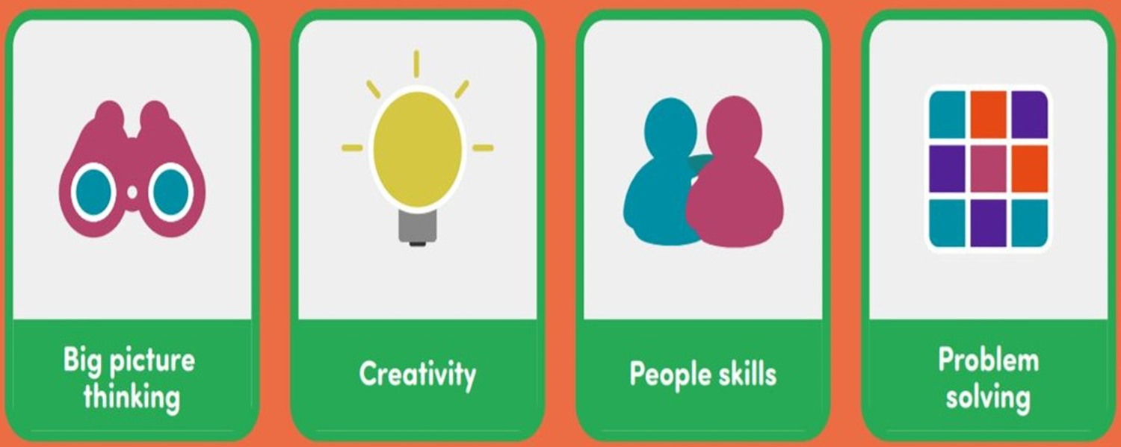
Dyslexic strengths
Notes:
These are some things that people with Dyslexia may have as strengths.

Slide 6
Dyslexic challenges
Notes:
These are things people with Dyslexia may find challenging.

Slide 7
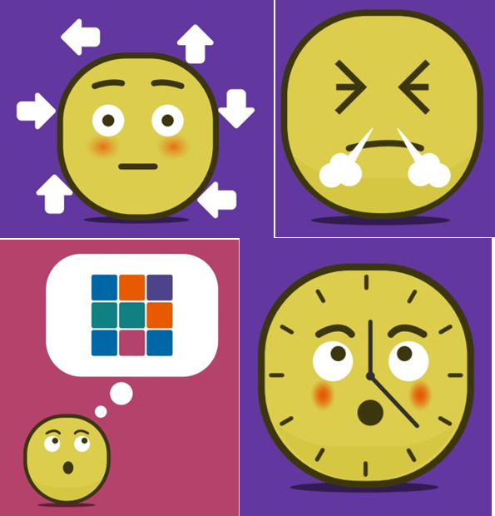
Dyslexia can make some people feel…
Tired
Angry
Embarrassed
Confused
Sad
Like they are no good…
Notes:
Dyslexia may make some people feel:
Tired
Angry
Embarrassed
Confused
Sad
Like they are no good…

Slide 8
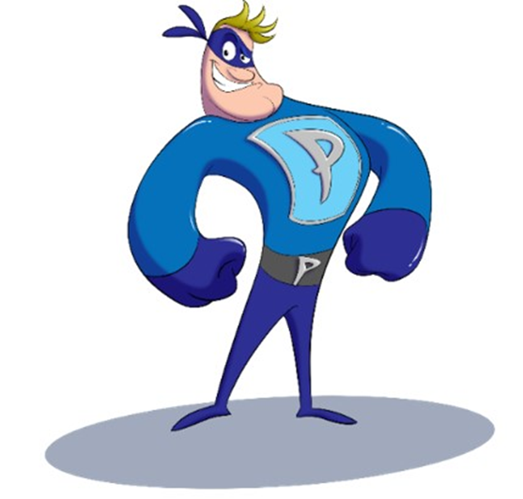
But some people feel that dyslexia is like having a superpower!
Once they find the things that will help, they can do anything.
There are lots of people who can help. People like parents, friends, teachers and employers.
Image copyright Mission Superheroes
Notes:
But some people feel that dyslexia is like having a superpower
Once they find the things that will help, they can do anything.
There are lots of people who can help. People like parents, friends, teachers and employers.

Slide 9
Some of the most famous and successful people in the world are dyslexic…
Actors
Entrepreneurs
Inventors
Chefs
Explorers
Lawyers...
Can you name any well known dyslexic people?
Notes:
Some of the most famous and successful people in the world are dyslexic…
Some well known people who have Dyslexia include:
Lewis Hamilton (F1 Driver)
Holly Willoughby (Presenter)
Jamie Oliver (chef)
Rio Ferdinand (Footballer)

Slide 10
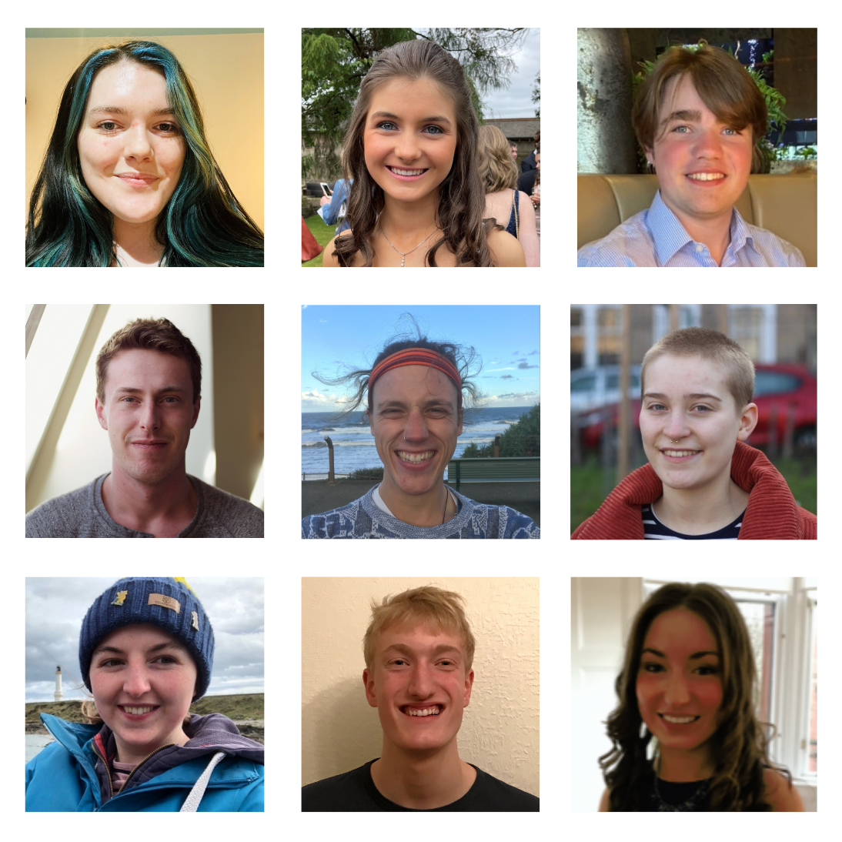
You don’t need to be famous to succeed…
…but Dyslexia Scotland’s Young Ambassadors are pretty special.
Notes:
But you don’t need to be famous to be successful.

Slide 11
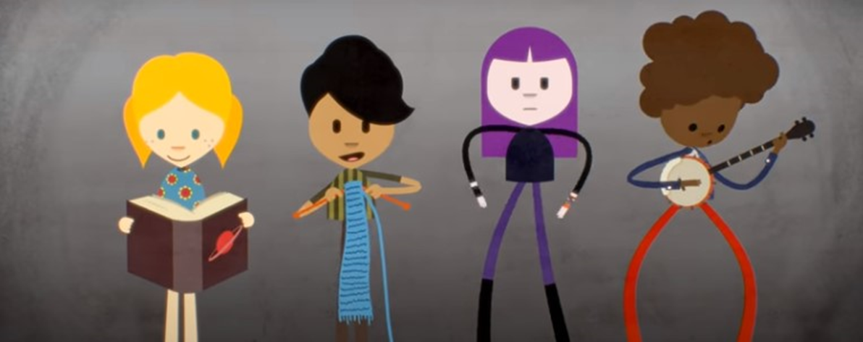
Want to know more?
Watch this short film called ‘See Dyslexia Differently’
Notes:
You will have time to watch these clips in your class this week.

Slide 12
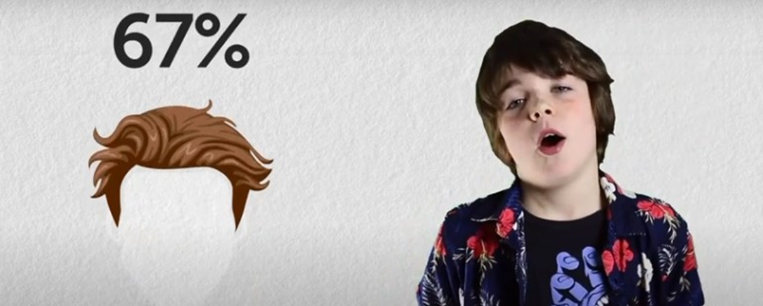
Miles thinks dyslexia is rubbish – and awesome
Here’s another short film – Miles give you the lowdown on his dyslexia

Slide 13
We would like as many people as possible to wear Ellie’s Blue Ribbon this week to raise awareness of Dyslexia.
Notes:
We would like as many people as possible to wear Ellie’s Blue Ribbon this week to raise awareness of Dyslexia.

Slide 14
Dyslexia friendly books
We are also going to work in partnership with the Reading Schools Committee to create a Dyslexia Friendly Books section within our school library.
Notes:
We are working with the Reading Schools Committee to create a Dyslexia Friendly Books section within our school library and will share more information about this soon.

